Slide 1
PAH156 - PDP Information Hierarchy - Mobile
Post-Test Analysis

Slide 2
Test Overview
1
Recap & Summary

Slide 3
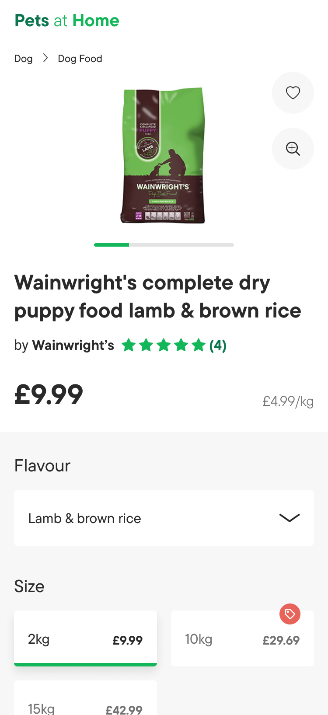
Rationale
Why did we run this test?
This test aims to validate the proposed Polestar mobile PDP designs, specifically the hierarchy of the above-the-fold information.
The proposed Polestar designs prioritise, in order, the products:
Image(s)
Title
Brand
Review star rating – if applicable
Price discount information (e.g. 10% off) – if applicable
Current price
Was price – if applicable
Normalised price (e.g. £10/kg) – if applicable
Testing this approach to the information hierarchy will give us insight into the most intuitive way for this information to be presented to the user.

Slide 4
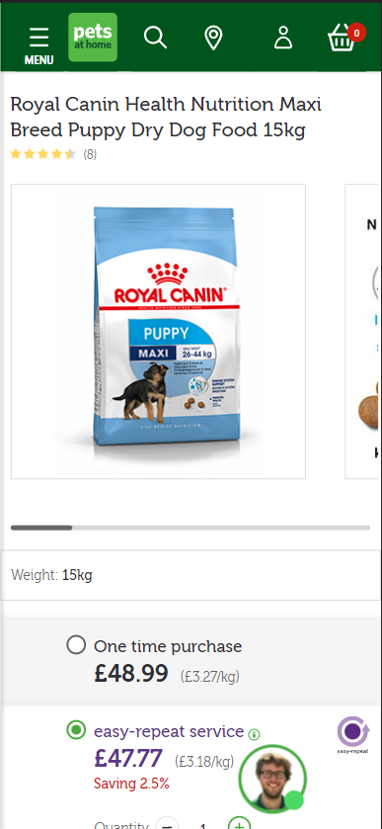
Control
What is the current experience?
The current PDP design follows the below hierarchy
Product title
Product review star rating
Product image(s)
Product Weight/Size
Product Purchase Options

Slide 5
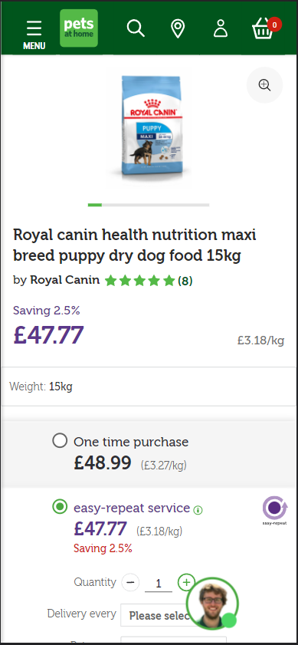
Variation 1
What did we change?
This variation makes several key changes to the design and hierarchy along with introducing additional functionality.
The hierarchy has been adjusted to the following order
Product image(s)
Product title
Product brand & review star rating
Product price information
Product weight/size
Product purchase options
This variation also refreshes the design of the first 4 elements in-line with the proposed Polestar designs.
In addition to the design and hierarchy changes, this variation also introduces a zoom feature to the product image(s)

Slide 6
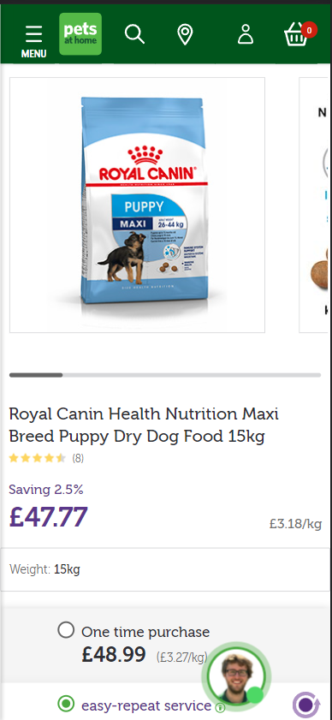
Variation 2
What did we change?
As with Variation 1, the hierarchy has been adjusted to the following order:
Product image(s)
Product title
Product brand & review star rating
Product price information
Product weight/size
Product purchase options
However, this variation does not feature the changes to the elements’ design or the addition of the zoom feature.

Slide 7
Configuration
Key Metrics & Segments
Where did the test run?
Across all Product Details Pages.
What browsers/devices did the test run on?
The test ran across all mobile devices and browsers.
How long was the test live?
The test ran from 2nd March 2022 to the 22nd March 2022. (20 days)
Key Metrics
The primary KPI that we will base the test’s success on is Add to Basket Rate.
For our secondary KPIs, we will measure the subsequent progression through the funnel to support our analysis of each variation.
We will also measure engagement with the product images, reviews & bounce rate, as well as focus on Easy Repeat & Click & Collect purchases to augment our understanding of the impact of each variation.
Key Segments
New & Returning Users
Paid Traffic Users (Google Shopping, Paid Social, & PPC Traffic)
Users that land on a PDP (the first page visited)

Slide 8
E-commerce Segment-Based Metrics
E-commerce Built-in Metrics
Add to Basket
Dimension: Shopping Stage
Value equals: ADD_TO_CART
Basket Progression
Dimension: Page Path
Value contains one of the following:
/shop/basket
/webapp/wcs/stores/servlet/checkoutbasket
Checkout Step 2 Progression
Event Category = Ecommerce
Event Action = Checkout Step
Event Label = 2
Checkout Step 3 Progression
Event Category = Ecommerce
Event Action = Checkout Step
Event Label = 3
Transactions
E-commerce Conversion Rate
Revenue
Avg. Order Value
Order Delivery Type
Order Type

Slide 9
Engagement Segment-Based Metrics
Engagement Built-in Metrics
Variant Impression
Custom Dimension: 22 (Optimisation Slot #1)
Value is one of the following:
pah156: Control
pah156: Variation 1
pah156: Variation 2
Gallery Image Impression
Event Category = CRO Test Event
Event Action = Gallery Image Engagement
Gallery Zoom Open
Event Category = CRO Test Event
Event Action = Gallery Zoom Open
Gallery Zoom Close
Event Category = CRO Test Event
Event Action = Gallery Zoom Close
Reviews Star Engagement
Event Category = CRO Test Event
Event Action = Reviews Star Engagement
Bounces
Bounce Rate
Heatmaps
PAH156: Control
PAH156: Variation 1
PAH156: Variation 2

Slide 10
Results & Insights
2
Summary

Slide 11
Results Summary
Insights Summary
Summary of overall performance data
This should be more quantitative-based.
Summary of insights gathered during analysis.
This should be more qualitative-based.
* Source of data

Slide 12
Results & Insights
3
Ecommerce & Engagement Performance

Slide 13
Add to Basket Rate
Variation 1 underperformed across All Users, with a 1.93% reduction in Add to Basket Rate. In contrast, Variation 2 outperformed the control across All Users with a 1.42% uplift in Add to Basket Rate.
This result is mostly attributable to New Users, who showed a preference for the Control with Variations 1 & 2 returning a 4.03% and 1.70% reduction in Add to Basket Rate, respectively.
Returning Users, however, were much more responsive to the Control with Variation 1 returning a minor increase of 0.18% and Variation 2 returning a major increase of 4.55%.
* Data can be seen here

Slide 14
E-commerce Funnel Performance
Aside from the notable increase in Add to Basket Rate on Variation 2 across All Users, subsequent funnel performance was reduced in both variations.
It is interesting to note that when segmenting the data by user type, we see Returning Users in the variations generally performing at the same or a higher level than the Control.
* Data can be seen here

Slide 15
Engagement Performance
While the E-commerce Funnel Performance results are discouraging, an explanation can be found when looking at the engagement-based metrics, namely Bounce Rate and Gallery Image Impression Rate.
The chart below shows Variation 1 consistently, though minimally, decreasing Bounce Rate across each user type and this was coupled with increased engagement with the Gallery element, with Image Impression Rate increasing across All Users and notable usage of the zoom functionality (there is no data shown below for the Control or Variation 2 as this feature isn’t present in them).
Typically, increased engagement would be positive as it suggests that users are progressing through the page and funnel but in this test, the variation that brought us the bigger improvements in engagement rates also brought us the bigger reductions in e-commerce performance.
The link between the increase in engagement and reduction in e-commerce performance is explored further on the next slide.
* Data can be seen here

Slide 16
Impact of Engagement on E-commerce Performance
The chart below shows the relative impact each variation had on the Gallery Image Impression, Add to Basket, & E-commerce Conversion Rates, in comparison to the control.
Here we can see that Gallery Image Impression Rate is negatively correlated with the Add to Basket and E-commerce Conversion Rates. This leads us to believe that the increase in Gallery Image Impressions directly reduces E-commerce performance.
Furthermore, we also believe that the disparity in behaviour among New and Returning Users – namely the 0.03% reduction in Gallery Image Impression Rate seen among New Users in Variation 1 compared to the 21.11% increase among Returning Users – is explained by an increased need for information among New Users, as these users may be unfamiliar with the product or comparing a previously bought product from another supplier, against that supplier. So the engagement with the images would naturally be higher among these users – New users in the Control have a 73.23% Gallery Image Impression Rate, compared to 60.37% among Returning Users in the Control.
* Data can be seen here

Slide 17
Impact of Engagement on E-commerce Performance
In contrast to Variation 1, Variation 2 saw reductions in Gallery Image Impression Rates across New & Returning Users. This is likely because the image/gallery elements were unchanged in this variation and only moved slightly further up the page. Users in Variation 1 may have felt an increased need to engage with the gallery to visually confirm their product choice due to the reduced image size.
Users in Variation 2 however, could quickly scan and confirm as on the Control. This is especially apparent among Returning Users, who would typically be expected to view products they have previously purchased or browsed and must’ve felt an increased and unnecessary sense of confusion in Variation 1, resulting in a large increase in Gallery Image Impression Rate. This increased cognitive load and created a friction point that has resulted in a negative impact on E-commerce Funnel Performance.
The key takeaway here isn’t that the option to engage with the gallery, i.e. zoom in/out, swiping, etc. is directly causing users to not progress through the e-commerce funnel, it’s that the requirement for users to engage is problematic, especially so for our returning users that are familiar with our site and are able to efficiently and effectively progress through the funnel. There may also be an element of Change Aversion at play here, but if so, it is likely a secondary factor due to the performance seen among New Users supporting this.
* Data can be seen here

Slide 18
Results Conclusion
5
Recommendations & Next Steps

Slide 19
Recommendations
Next Steps
Recommendations based on results of test.
Detailed list of the immediate steps to follow the conclusion of this test.
Defer Next Steps to wider Optimisation & UX Team.

